Slide 1
HTML Form

Slide 2
1 - Creating a form

Slide 3

Overview of Forms
Forms are used all over the Web to
  Accept information
  Provide interactivity
Types of forms:
  Search form, Order form, Newsletter sign-up form, Survey form, Add to Cart form, and so on…

Slide 4
Two Components of Using Forms
1. The web page form
  An HTML element that contains and organizes form controls such as text boxes, check boxes, and buttons that can accept information from website visitors.
and
2. The server-side processing
  Server-side processing works with the form data and sends e-mail, writes to a text file, updates a database, or performs some other type of processing on the server.

Slide 5
HTML Using Forms
<form> tag
  Contains the form elements on a web page
  Container tag
<input> tag
  Configures a variety of form elements including text boxes, radio buttons, check boxes, and buttons
  Stand alone tag
<textarea> tag
  Configures a scrolling text box
  Container tag
<select> tag
  Configures a select box (drop down list)
  Container tag
<option> tag
  Configures an option in the select box
  Container tag

Slide 6
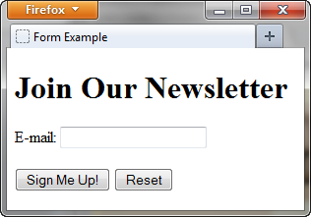
Sample Form HTML
<form>
E-mail: <input type="text" name="email" id="email" >
<br><br>
<input type="submit" value="Sign Me Up!"> <input type="reset">
</form>

Slide 7
The Form Element
<form>
Container Tag
The form element attributes:
  action
    Specifies the server-side program or script that will process your form data
  method
    get – default value,
    form data passed in URL
    post – more secure,
    form data passed in HTTP Entity Body
  name
    Identifies the form
  id
    Identifies the form

Slide 8

The Input Element Text Box
<input>
Accepts text information
Common Attributes:
  type=“text”
  name
  id
  size
  maxlength
  value
  required (HTML5)
  placeholder (HTML5)

Slide 9

The Input Element Password Box
<input>
Accepts text information that needs to be hidden as it is entered
Common Attributes:
  type=“password”
  name
  id
  size
  maxlength
  value
  required (HTML5)
  placeholder (HTML5)

Slide 10
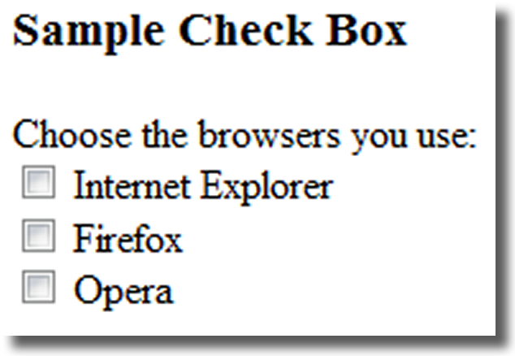
The Input Element Check box
<input>
Allows the user to select one or more of a group of predetermined items
Common Attributes:
  type=“checkbox”
  name
  id
  checked
  value

Slide 11
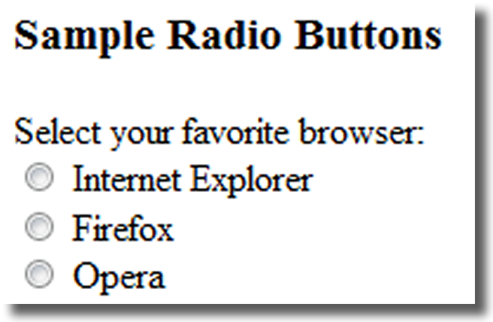
The Input Element Radio Button
<input>
Allows the user to select exactly one from a group of predetermined items
Each radio button in a group is given the same name and a unique value
Comon Attributes:
  type=“radio”
  name
  id
  checked
  value

Slide 12
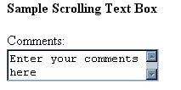
The Textarea Element
<textarea>
Configures a scrolling text box
Common Attributes:
  name
  id
  cols
  rows

Slide 13

The Select Element
<select>
Configures a select list (along with <option> tags)
Also known as: Select Box, Drop-Down List, Drop-Down Box, and Option Box.
Allows the user to select one or more items from a list of predetermined choices.
Common Attributes:
  name
  id
  size
  multiple

Slide 14
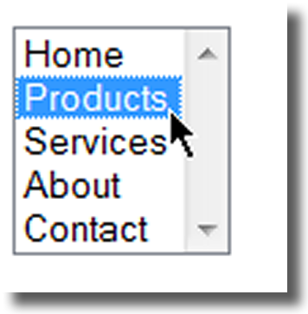
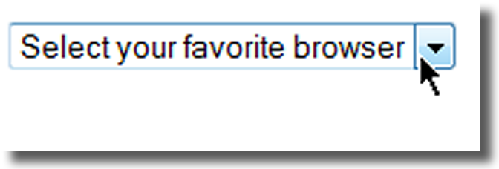
The Option Element
<option>
Configures the options in a Select List
Attributes:
  value
  selected

Slide 15
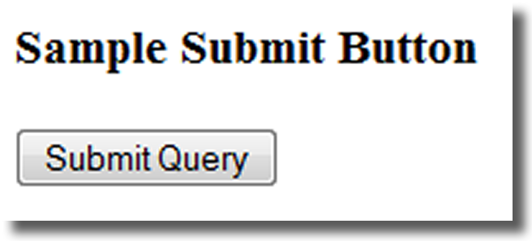
The Input Element Submit Button
<input>
Submits the form information
When clicked:
  Triggers the action method on the <form> tag
  Sends the form data (the name=value pair for each form element) to the web server.
Attributes:
  type=“submit”
  name
  id
  value

Slide 16
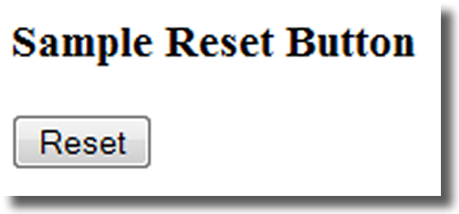
The Input Element Reset Button
<input>
Resets the form fields to their initial values
Attributes:
  type=“reset”
  name
  id
  value

Slide 17
The Input Element Hidden Field
<input>
This form control is not displayed on the Web page.
Hidden form fields
  Can be accessed by both client-side and server-side scripting
Common Attributes:
  type=“hidden”
  name
  id
  value

Slide 18
The Label Element
<label>
Associates a text label with a form control
Two Different Formats:
<label>Email: <input type="text" name="CustEmail" id ="CustEmail"></label>
Or
<label for="email">Email: </label>
<input type="text" name="CustEmail" id= "email" />

Slide 19
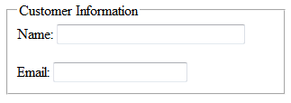
The Fieldset & Legend Elements
The Fieldset Element
<fieldset>
  Container tag
  Creates a visual
  group of form controls
  on a web page
The Legend Element
<legend>
  Container tag
  Creates a text label within the fieldset
<fieldset><legend>Customer Information</legend>
<label>Name:
<input type="text" name="CName" id="CName" size="30"></label> <br><br >
<label>Email:
<input type="text" name="CEmail" id="CEmail"></label>
</fieldset>

Slide 20
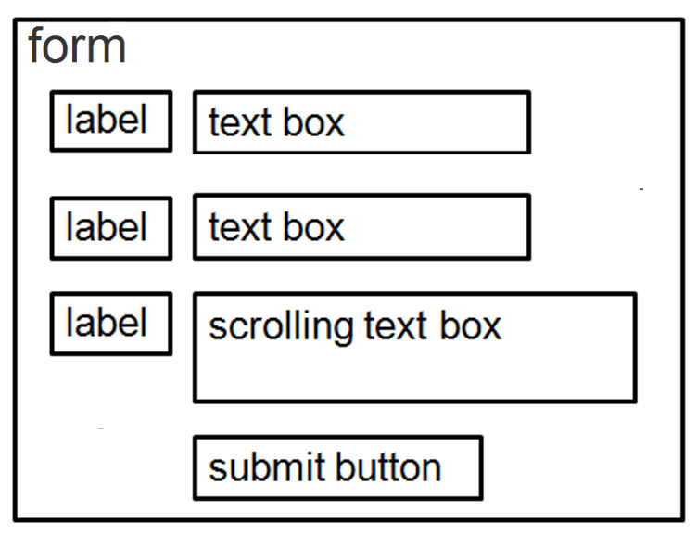
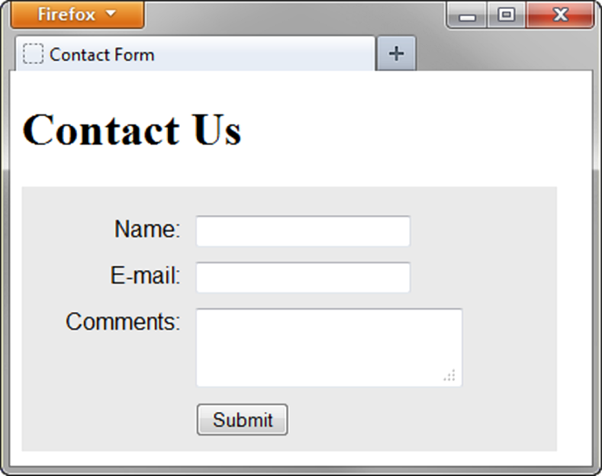
Using CSS to Style a Form
form { background-color:#eaeaea; font-family: Arial, sans-serif;
width: 350px; padding: 10px;}
label { float: left; clear: left; display: block; width: 100px;
text-align: right; padding-right: 10px; margin-top: 10px; }
input, textarea { margin-top: 10px; display: block;}
#mySubmit { margin-left: 110px; }

Slide 21
Form - <form>
<form action = ".."
method = "...">
...
</form>
action = URL
method = get | post
http://www.w3schools.com/tags/tag_form.asp

Slide 22
Text field - <input>
For single line text input:
<input type = "text"
name = "mytextfield"
value = "initial value"
size = "50"
maxlength = "50"/>
http://www.w3schools.com/tags/tag_input.asp

Slide 23
Password - <input>
For single line masked text input
<input type = "password"
name = "pwd"/>

Slide 24
Radio button - <input>
Single choice
Male: <input type = "radio" name = "gender" value="Male"/>
Female: <input type = "radio" name = "gender" value="Female"/>

Slide 25
Checkbox - <input>
Multiple choice
<input type = "checkbox"
name = "sailing"/>

Slide 26
Labelling
Old School (Strict DTD only):
<input type="checkbox" name="choice1"> Choice 1
</input>
Strict DTD compliant:
Choice 1: <input type="checkbox" name="choice1/>
Elegant:
<label for="choice1ID">Choice 1</label>
<input type="checkbox" name="choice1 id="choice1ID"/>

Slide 27
Drop-down list
<select><option>
Single choice
<select name="country" size="1">
<option value="UK">United Kingdom</option>
<option value="USA">United States of America</option>
<option value="NK">North Korea</option>
<option value="BE">Belgium</option>
</select>

Slide 28
(multiple) selection list
<select><option>
Multiple choice
<select name="country[]" size="3" multiple="multiple">
<option value="UK">United Kingdom</option>
<option value="USA">United States of America</option>
<option value="NK">North Korea</option>
<option value="BE">Belgium</option>
</select>

Slide 29
Text area - <textarea>
For multiple line text input
<textarea name="myTextArea"
cols="30"
rows="5">
</textarea>
http://www.w3schools.com/tags/tag_textarea.asp

Slide 30
Hidden fields - <input>
To send information with the form
<input type="hidden"
name="hidden1"
value="Form example for demo"/>

Slide 31
Button - <input> or <button>
<input type="submit"
name="submitButton"
value="Submit Form"/>
<button type="submit"
name="submitButton">
SubmitForm
</button>

Slide 32
What are forms?
<form> is just another kind of XHTML/HTML tag
Forms are used to create (rather primitive) GUIs on Web pages
  Usually the purpose is to ask the user for information
  The information is then sent back to the server
A form is an area that can contain form elements
  The syntax is: <form parameters> ...form elements... </form>
  Form elements include: buttons, checkboxes, text fields, radio buttons, drop-down menus, etc
    Other kinds of tags can be mixed in with the form elements
  A form usually contains a Submit button to send the information in he form elements to the server
  The form’s parameters tell JavaScript how to send the information to the server (there are two different ways it could be sent)
  Forms can be used for other things, such as a GUI for simple programs

Slide 33
Forms and JavaScript
The JavaScript language can be used to make pages that “do something”
  You can use JavaScript to write complete programs, but...
  Usually you just use snippets of JavaScript here and there throughout your Web page
  JavaScript code snippets can be attached to various form elements
    For example, you might want to check that a zipcode field contains a 5-digit integer before you send that information to the server
Microsoft calls its version of JavaScript “active scripting”
Forms can be used without JavaScript, and JavaScript can be used without forms, but they work well together
JavaScript for forms is covered in a separate lecture

Slide 34
The <form> tag
The <form arguments> ... </form> tag encloses form elements (and probably other elements as well)
The arguments to form tell what to do with the user input
  action="url" (required)
    Specifies where to send the data when the Submit button is clicked
  method="get" (default)
    Form data is sent as a URL with ?form_data info appended to the end
    Can be used only if data is all ASCII and not more than 100 characters
  method="post"
    Form data is sent in the body of the URL request
    Cannot be bookmarked by most browsers
  target="target"
    Tells where to open the page sent as a result of the request
    target= _blank means open in a new window
    target= _top means use the same window

Slide 35
The <input> tag
Most, but not all, form elements use the input tag, with a type="..." argument to tell which kind of element it is
  type can be text, checkbox, radio, password, hidden, submit, reset, button, file, or image
Other common input tag arguments include:
  name: the name of the element
  id: a unique identifier for the element
  value: the “value” of the element; used in different ways for different values of type
  readonly: the value cannot be changed
  disabled: the user can’t do anything with this element
  Other arguments are defined for the input tag but have meaning only for certain values of type

Slide 36



Text input
A text field:
<input type="text" name="textfield" value="with an initial value" />
A multi-line text field
<textarea name="textarea" cols="24" rows="2">Hello</textarea>
A password field:
<input type="password" name="textfield3" value="secret" />
• Note that two of these use the input tag, but one uses textarea

Slide 37
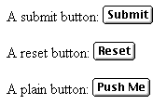
Buttons
A submit button:
<input type="submit" name="Submit" value="Submit" />
A reset button:
<input type="reset" name="Submit2" value="Reset" />
A plain button:
<input type="button" name="Submit3" value="Push Me" />
submit: send data
reset: restore all form elements to their initial state
button: take some action as specified by JavaScript
• Note that the type is input, not “button”

Slide 38

Radio buttons
Radio buttons:<br>
<input type="radio" name="radiobutton" value="myValue1" />
male<br>
<input type="radio" name="radiobutton" value="myValue2”
checked="checked" />female
If two or more radio buttons have the same name, the user can only select one of them at a time
  This is how you make a radio button “group”
If you ask for the value of that name, you will get the value specified for the selected radio button
As with checkboxes, radio buttons do not contain any text

Slide 39
Labels
In many cases, the labels for controls are not part of the control
  <input type="radio" name="gender" value="m" />male
  In this case, clicking on the word “male” has no effect
A label tag will bind the text to the control
  <label><input type="radio" name="gender" value="m" />male</label>
  Clicking on the word “male” now clicks the radio button
w3schools says that you should use the for attribute:
  <label for="lname">Last Name:</label>
  <input type="text" name="lastname" id="lname" />
  In my testing (Firefox and Opera), this isn’t necessary, but it may be for some browsers
Labels also help page readers read the page correctly
Some browsers may render labels differently

Slide 40
Checkboxes
A checkbox:
<input type="checkbox" name="checkbox"
value="checkbox" checked="checked">
type: "checkbox"
name: used to reference this form element from JavaScript
value: value to be returned when element is checked
Note that there is no text associated with the checkbox
  Unless you use a label tag, only clicking on the box itself has any effect

Slide 41

Drop-down menu or list
A menu or list:
<select name="select">
<option value="red">red</option>
<option value="green">green</option>
<option value="BLUE">blue</option>
</select>
Additional arguments:
  size: the number of items visible in the list (default is "1")
  multiple
    if set to "true" (or just about anything else), any number of items may be selected
    if omitted, only one item may be selected
    if set to "false", behavior depends on the particular browser

Slide 42
Hidden fields
<input type="hidden" name="hiddenField" value="nyah">
&lt;-- right there, don't you see it?
What good is this?
  All input fields are sent back to the server, including hidden fields
  This is a way to include information that the user doesn’t need to see (or that you don’t want her to see)
  The value of a hidden field can be set programmatically (by JavaScript) before the form is submitted

Slide 43
A complete example
<html>
<head>
<title>Get Identity</title>
<meta http-equiv="Content-Type" content="text/html;
charset=iso-8859-1">
</head>
<body>
<p><b>Who are you?</b></p>
<form method="post" action="">
<p>Name:
<input type="text" name="textfield">
</p>
<p>Gender:
<label><input type="radio" name="gender" value="m" />Male<label>
<label><input type="radio" name="gender" value="f" />Female</label>
</p>
</form>
</body>
</html>

Slide 44
โครงสร้าง Element สำหรับสร้างแบบฟอร์ม
<form name="form_name" method="get | post" action="url" target="window name">....</form>
- name="ชื่อของ Form"
- method="get | post" เป็นรูปแบบของวิธีในการส่งข้อมูล มี 2 รูปแบบ
get เป็นตัวรับ - ส่ง ข้อมูลขนาดจำกัดจาก Server ไม่เกิน 256 ตัวอักษร
post เป็นตัวรับ - ส่ง ข้อมูลไม่จำกัดจาก Server
- action="URL" คือตำแหน่งหรือ URL ของ Script ที่วางไว้ที่ Server
- target="_blank | _self | _parent" หน้าต่างที่จะให้ผลของ Script แสดงผล

Slide 45
ภายใน Element <form>...</form> จะประกอบด้วยช่อง element 3 ประเภท คือ
1. <input>...</input>
2. <select>...</select>
3. <textarea>

Slide 46
1. Input
input มีหลายประเภท ได้แก่

Slide 47
1) Text Fields <form>
< input type="text" name="ชื่อช่องกรอกข้อมูล" value="ข้อมูล" size="number" maxlength="number" disabled readonly />
< /form>
หรือ เพื่อให้เป็นไปตามมาตรฐานของ (X)HTML รุ่นใหม่ จะเขียนแบบนี้ <form>
<input type="text" name="ชื่อช่องกรอกข้อมูล" value="ข้อมูล" size="number" maxlength="number" disabled="disabled" readonly="readonly" />
</form>
- size="number" ความกว้างของช่องกรอกข้อมูล
- maxlengt="number" จำนวนตัวอักษรสูงสุดที่กรอกได้
- disabled lock ไม่ให้ช่องกรอกข้อมูลใช้งานได้
- readonly ให้ช่องกรอกข้อมูลอ่านได้อย่างเดียว กรอกข้อมูลไม่ได้

Slide 48
Example
<input type="text" name="txt_user" value="default value" size="20" maxlength="30"/>
<input type="text" name="txt_user" value="default value" size="40" maxlength="30" disabled="disabled" />
<input type="text" name="txt_user" value="readonly" size="20" maxlength="30" readonly="readonly" />
Output

Slide 49
2) Checkbox <form>
< input type="checkbox" name="ชื่อ checkbox" value="ค่าข้อมูล" checked>
< /form>
หรือ เพื่อให้เป็นไปตามมาตรฐานของ (X)HTML รุ่นใหม่ จะเขียนแบบนี้ <form>
<input type="checkbox" name="ชื่อ checkbox" value="ค่าข้อมูล" checked="checked" />
</form>
- checked = ให้ checkbox นั้นถูกเลือก (tick / ที่ checkbox)

Slide 50
Example
<input type="checkbox" name="selection1" value="Yes" checked="checked" /> Selection 1
<input type="checkbox" name="selection2" value="Yes" /> Selection 2
<input type="checkbox" name="selection3" value="Yes" /> Selection 3

Slide 51
3) Radio <form>
< input type="radio" name="ชื่อ radio" value="ค่าข้อมูล"checked="checked" />
< /form>
- checked = ให้ option นั้นถูกเลือก
Example <input type="radio" name="sex" value="M" checked="checked" />
<input type="radio" name="sex" value="F" /> Female

Slide 52
4) Password <form>
< input type="password" name="ชื่อ input password" value="ค่าข้อมูล" size="number" maxlength="number" />
< /form>
Example <input type="password" name="txt_passw" value="1234" size="10" maxlength="30" />

Slide 53
5) File upload <form>
< input type="file" name="ชื่อ input file" value="ค่าข้อมูล" size="number" maxlength="number" />
< /form>
Example <input type="file" name="filename" size="30" />

Slide 54
6) Hidden <form>
< input type="hidden" name="ชื่อ input hidden" value="ค่าข้อมูล" />
< /form>
Example <input type="hidden" name="id" value="1234" />

Slide 55
7) Button <form>
< input type="button" name="ชื่อ button" value="ค่าข้อมูล" />
< /form>
Example <input type="button" name="cancel" value="Cancel" />

Slide 56
8) Submit <form>
< input type="button" name="ชื่อ button" value="ค่าข้อมูล" />
< /form>
Example <input type="button" name="save" value="Save" />

Slide 57
9) Reset <form>
< input type="button" name="ชื่อ button" />
< /form>
Example <input type="reset" name="Clear" />

Slide 58
2. Select
<form>
< select name="ชื่อ select" size="5" multiple>
< option value="1" selected="selected">option 1</option>
< option value="2">option 2</option>
< option value="3">option 3</option>
< option value="4">option 4</option>
< option value="5">option 5</option>
< /select>
< /form>
- size = จำนวนตัวเลือกที่ให้มองเห็น
- multiple = ให้ผู้ใช้งานเลือกหลายตัวเลือกได้ โดยกดปุ่ม Ctrl

Slide 59
Example
<select name="list">
<option value="1">option 1</option>
<option value="2">option 2</option>
<option value="3"selected="selected">option 3</option>
<option value="4">option 4</option>
<option value="5">option 5</option>
</select>

Slide 60
Example
<select name="list" size="3">
<option value="1">option 1</option>
<option value="2">option 2</option>
<option value="3" selected="selected">option 3</option>
<option value="4">option 4</option>
<option value="5">option 5</option>
</select>

Slide 61
Example
<select name="list" size="5" multiple>
<option value="1">option 1</option>
<option value="2">option 2</option>
<option value="3" selected="selected">option 3</option>
<option value="4">option 4</option>
<option value="5">option 5</option>
</select>

Slide 62
<form>
< textarea name="ชื่อ textarea" rows="number" cols="number" wrap="off">
ข้อความใน textareas
< /textarea>
< /form>
- wrap การกำหนดการตัดคำหรือขึ้นบรรทัดใหม่ให้ข้อความที่ยาวต่อเนื่องกันมากๆ ใน textarea
มีค่าได้ 3 แบบ คือ
1. off (เป็นค่า default) ไม่มีการตัดคำหรือขึ้นบรรทัดใหม่ ข้อความจะถูกพิมพ์ไปเรื่อย ๆ และขึ้นบรรทัดใหม่เมื่อผู้กรอกเคาะ Enter เท่านั้น
2. physical หรือ soft ข้อความจะถูกพิมพ์ไปเรื่อย ๆ และ้ตัดคำหรือขึ้นบรรทัดใหม่ เมื่อข้อความยาวกว่าขนาดของ textarea และจุดใดที่ผู้ใช้เคาะ Enter ก็จะขึ้นบรรทัดใหม่ให้ตามที่พิมพ์
3. virtual หรือ hard ข้อความจะถูกพิมพ์ไปเรื่อย ๆ และ้ตัดคำหรือขึ้นบรรทัดใหม่ เมื่อข้อความยาวกว่าขนาดของ textarea แต่เป็นการปัดหลอกๆ ในหน้ากรอกข้อความ เวลารับค่าจะเป็นบรรทัดเดียว

